Slide 1
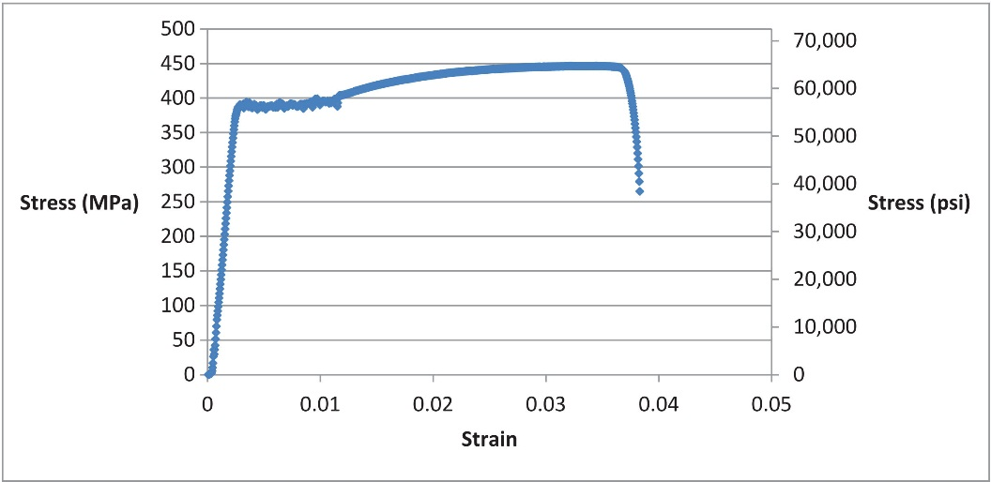
FIGURE 3.1 Stress–Strain Graph for Testing a Steel Bar in Tension

Slide 2
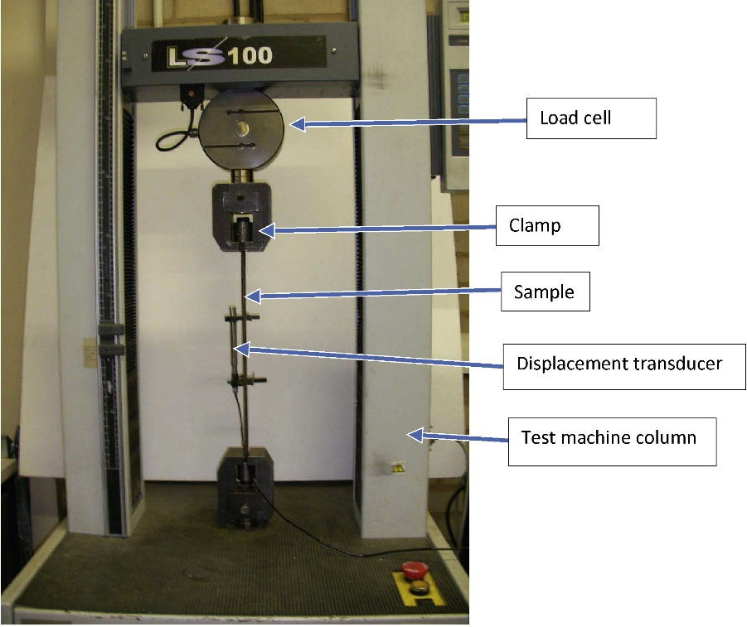
FIGURE 3.2 Arrangement of Steel Test Sample

Slide 3
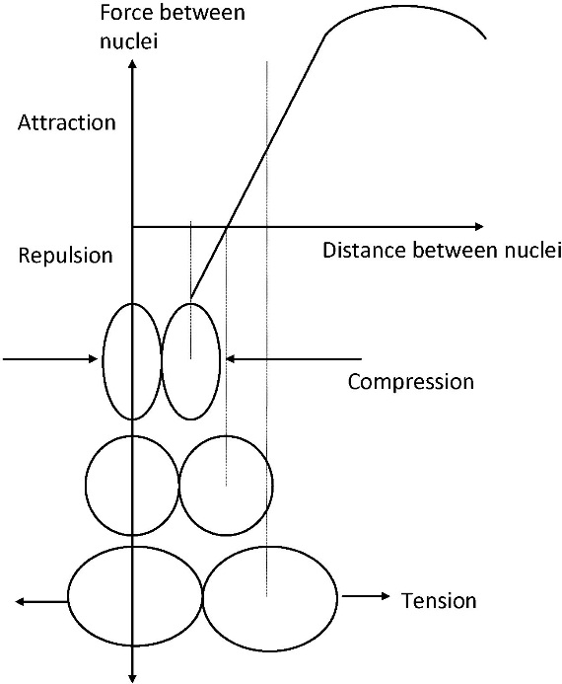
FIGURE 3.3 Effect of Applied Stress on Atoms in Material

Slide 4
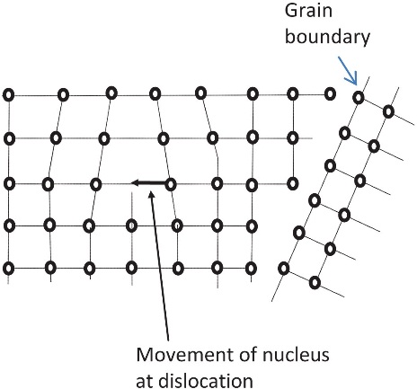
FIGURE 3.4 Structure of Crystalline
Material (e.g., Metal)

Slide 5
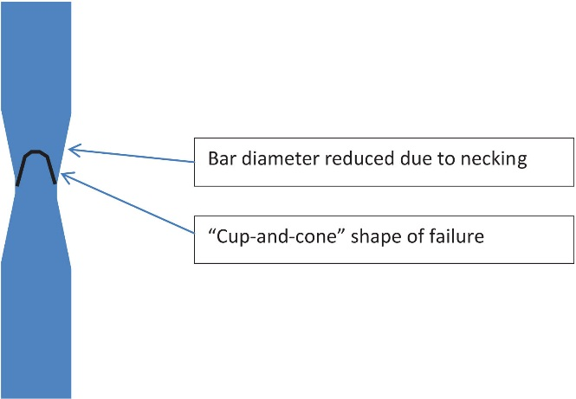
FIGURE 3.5 Typical Detail of Failure of Steel Bar

Slide 6
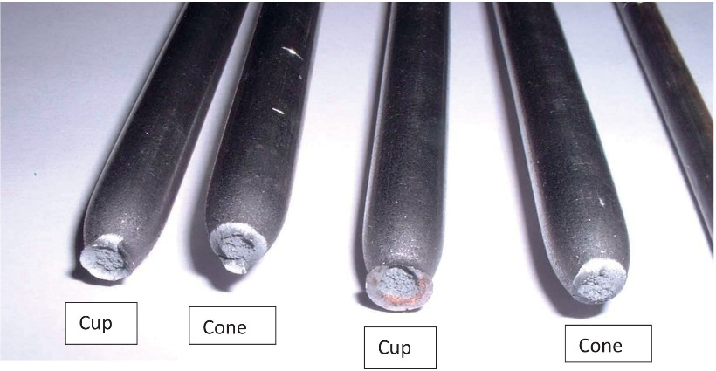
FIGURE 3.6 Steel Samples After Failure

Slide 7
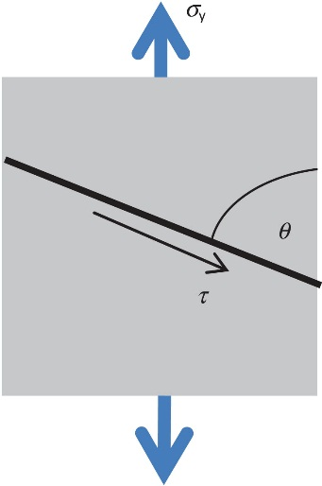
FIGURE 3.7 A Finite Element of Steel

Slide 8
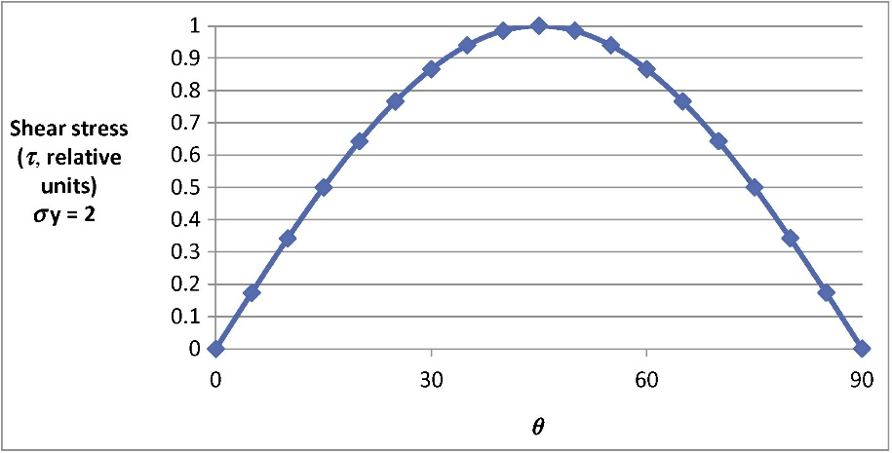
FIGURE 3.8 Shear Force at Angle to Applied Load

Slide 9
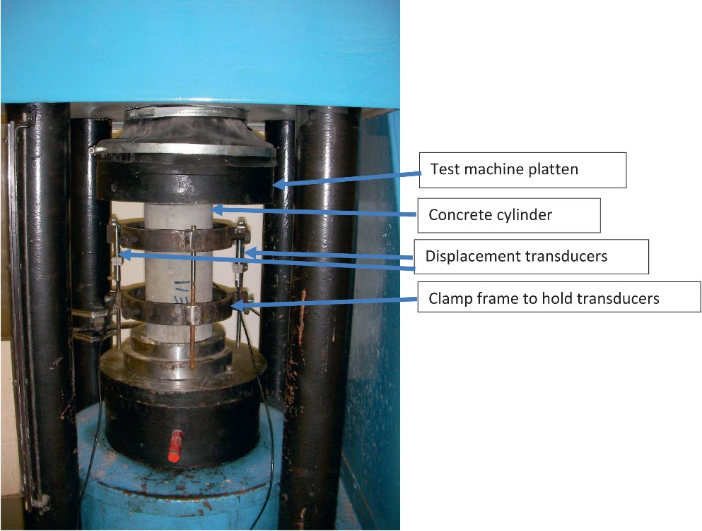
FIGURE 3.9 Testing a Concrete Cylinder

Slide 10
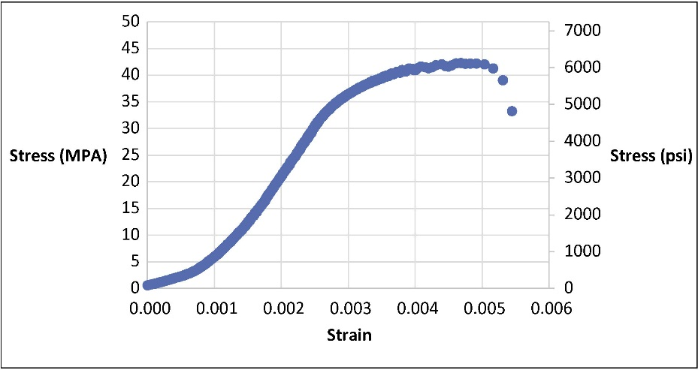
FIGURE 3.10 Stress–Strain Graph for Testing a Concrete Cube

Slide 11
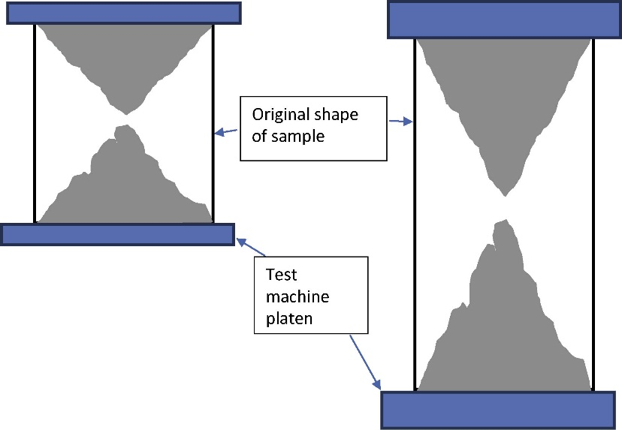
FIGURE 3.11 Typical Shape of Failed Cube (Left) and Cylinder (Right)

Slide 12
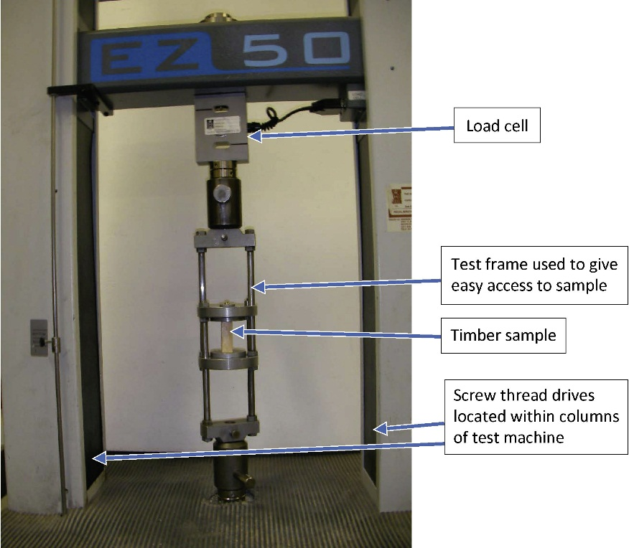
FIGURE 3.12 Testing a Timber Sample on End Grain

Slide 13
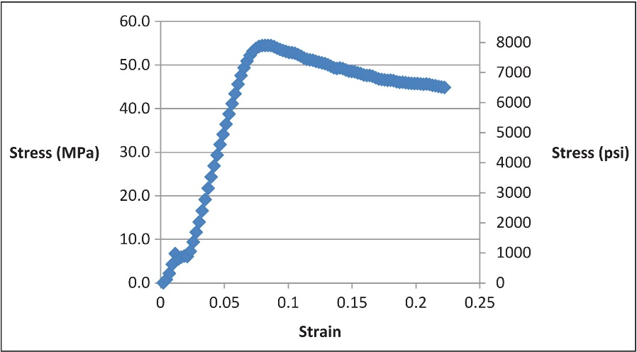
FIGURE 3.13 Stress–Strain Curve for Timber Loaded Parallel to the Grain

Slide 14
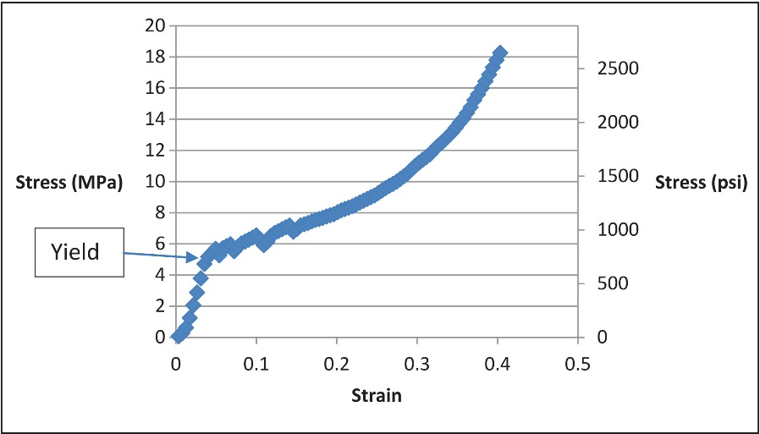
FIGURE 3.14 Stress–Strain Curve for Timber Loaded at Right Angles to the Grain

Slide 15
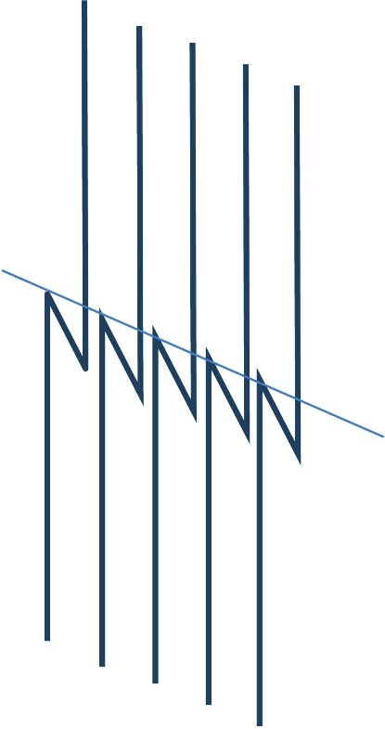
FIGURE 3.15 Schematic Diagram of Failure in End Grain Loading

